Slide 1
Welcome to the webinar:
Agency Operations, a POV
with
Glenn
Towle

Slide 2
Glenn Towle
Partner
COO
CFO

Slide 3
MomentumAgencyAdvisors.com

Slide 4
Empowerment
Initiative
Responsibility
Accountability

Slide 5
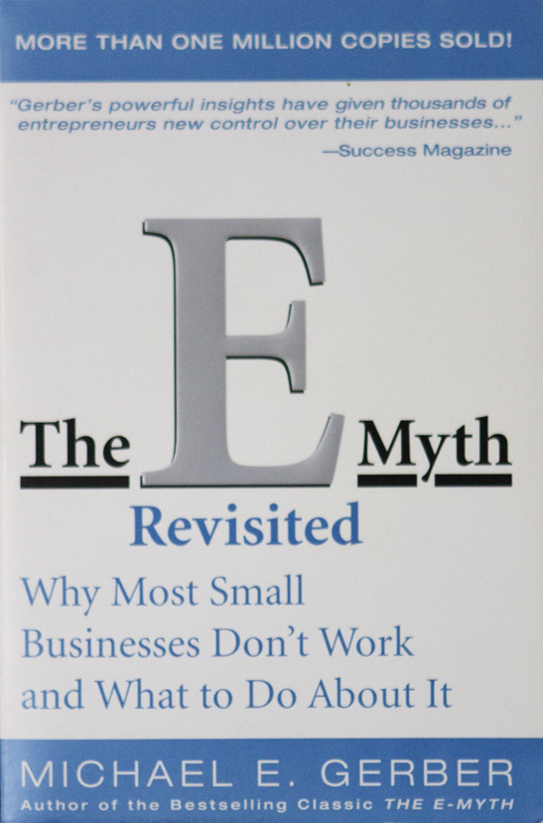
Work “on”
the business,
not “in” the business.

Slide 6
Owners working “on” the business:
Strategic Vision
Company Culture
Build the Team

Slide 7
Agency
Mgmt
101

Slide 9
Owners working “on” the business:
Strategic Vision
Company Culture
Build the Team

Slide 10
www.youtube.com/user/momentumadvisor

Slide 11
Go ahead, work “in” your business:
Creative
Media
Client Service

Slide 12
An
Empowered Culture

Slide 13
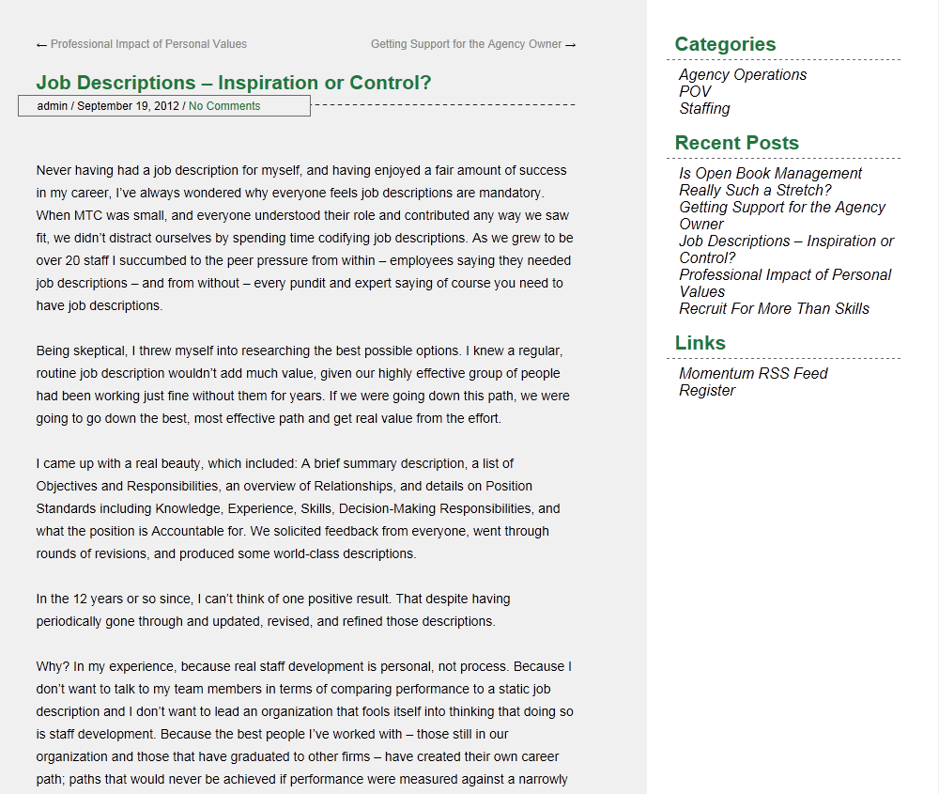

Slide 14
A Culture of Empowerment

Slide 15
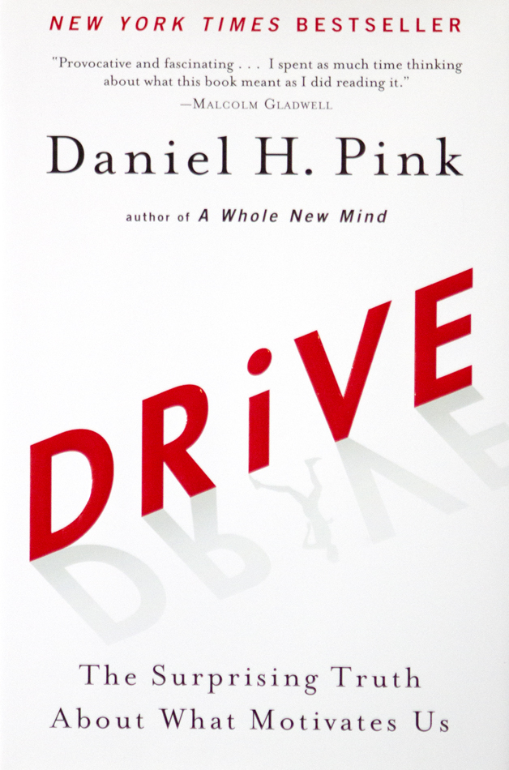
Motivation
Autonomy
Mastery
Purpose

Slide 17
Define the Culture
Values Statements
Role Statement

Slide 18
My role is to create opportunities for others.

Slide 21
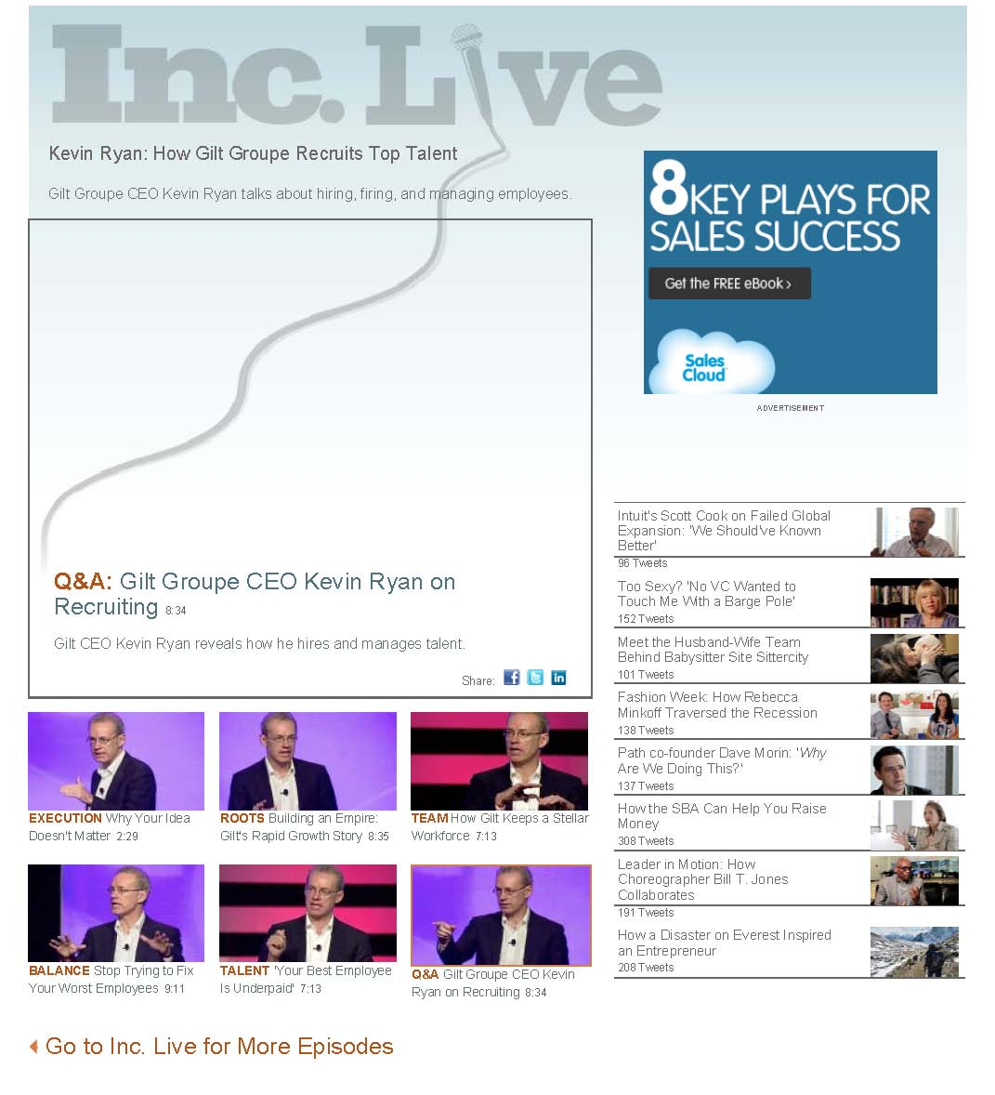

Slide 22
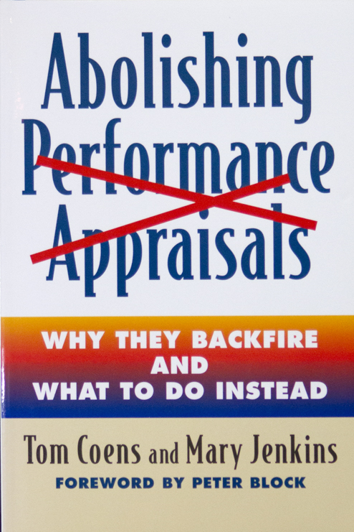

Slide 24
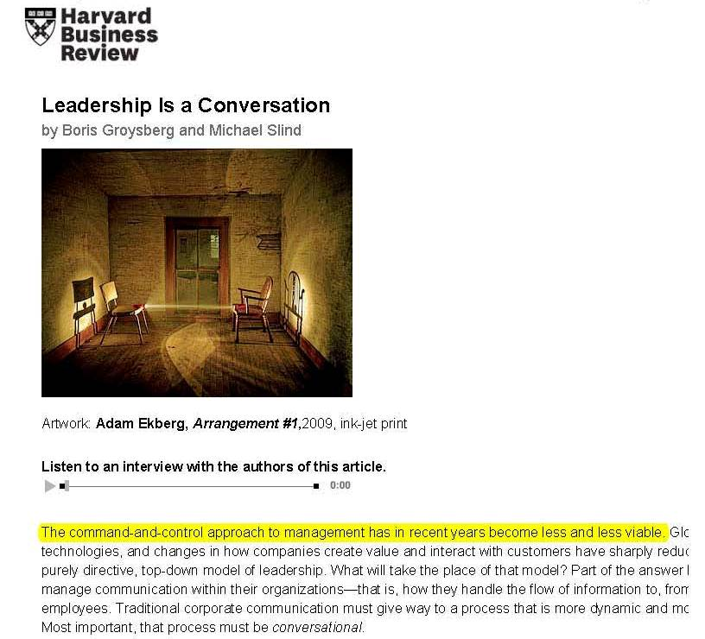
Interpersonal Conversation
Intimacy
Interactivity
Inclusion
Intentionality

Slide 25
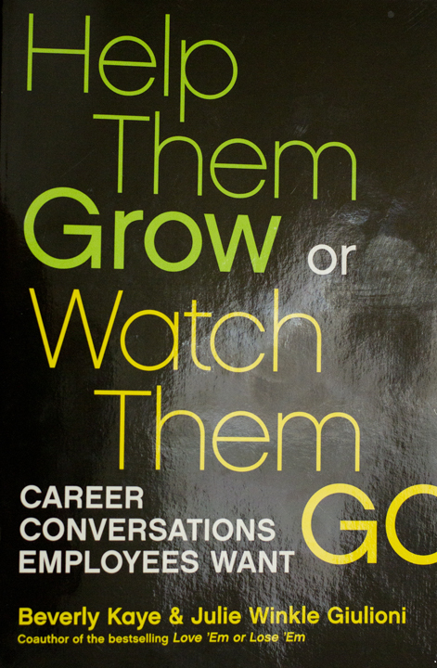

Slide 26
www.youtube.com/user/momentumadvisor

Slide 27
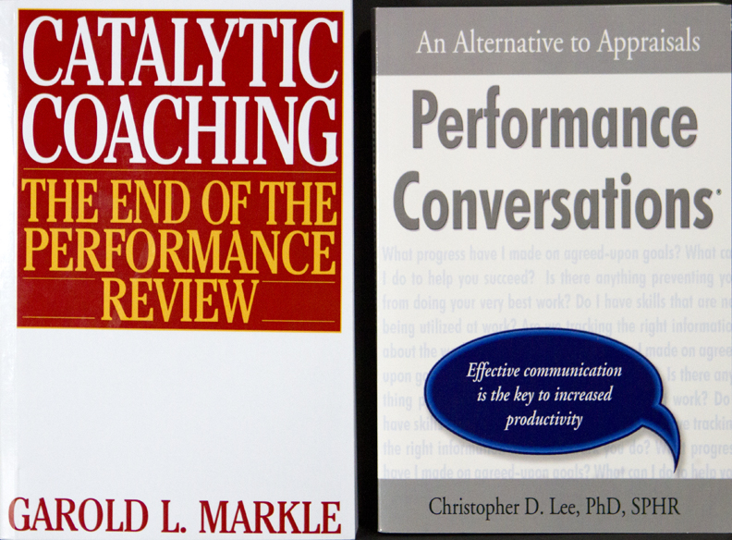

Slide 28
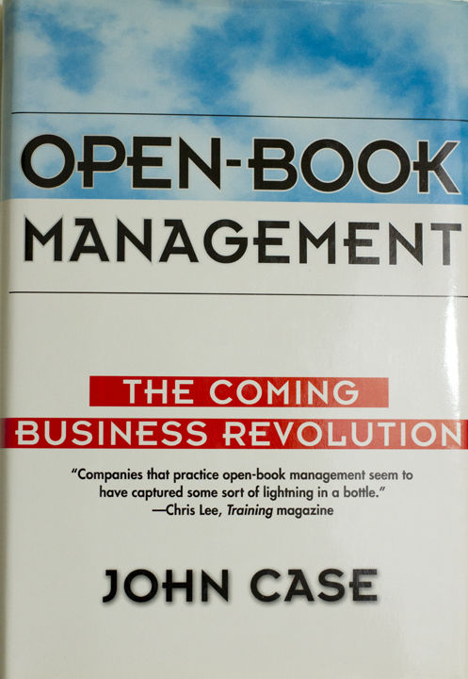

Slide 29
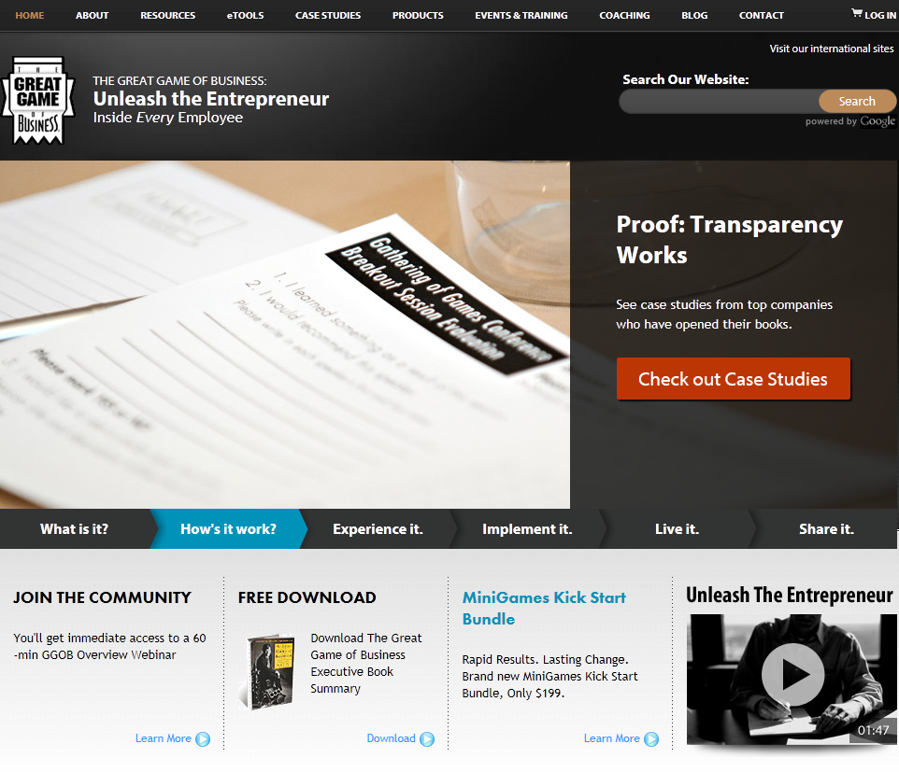

Slide 30
Empowerment
Initiative
Responsibility
Accountability

Slide 31
Open Book Management
Time Involved
Don’t Get It
Exposure
Where’s Mine?

Slide 32
You
are the source
of the change
you seek.

Slide 33
gtowle@momentumagencyadvisors.com
MomentumAgencyAdvisors.com
@GlennTowle

Slide 34
Resources:
The E Myth Revisited, by Michael E. Gerber
www.youtube.com/user/momentumadvisor
http://momentumagencyadvisors.com/blog/
Drive, by Daniel Pink
Good To Great, by Jim Collins
Inc. Magazine Online – Kevin Ryan of Gilt Group, http://www.inc.com/kevin-ryan/kevin-ryan-how-gilt-groupe-recruits-top-talent.html
Abolishing Performance Appraisals, by Tom Coen and Mary Jenkins
Harvard Business Review, June 2012: Leadership Is a Conversation, by Boris Groysberg and Michael Slind, http://hbr.org/2012/06/leadership-is-a-conversation/ar/1
Help Them Grow or Watch Them Go, by Beverly Kaye & Julie Winkle Giulioni
Catalytic Coaching, by Garold L. Markle
Performance Conversations, by Christopher D. Lee
Open Book Management, by John Case
http://greatgame.com/

