Slide 1
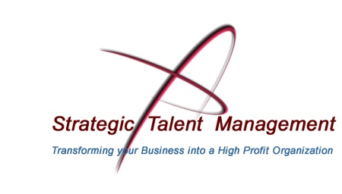

Transforming your Business into
a High Profit Organization
The Science of Hiring
April 2, 2013

Slide 2

Why Are We here?
© Strategic Talent Management, 2013
2
We can dramatically improve the accuracy of your hiring decisions:
Documented 92% success rate
80% lower turnover
$2,000,000 savings
$20 savings
Notes:
--92% is system wide using our TALENT MANAGEMENT PLUS system—but many of my long-time AMR clients would agree we maintain this average or better on our hiring assessments alone.’
--80% is the maximum reduction in a 300 person firm—they were at twice their industry average and we took them to about ½ the industry average after one year.
--$2,000,000—story from an AMR member—new Accounts person in 2008, business softening, SO THEY DECIDED TO SAVE MONEY AND NOT ASSESS THEM-- long term clients falling away—turned out their oldest best client called to tell them what was going on. They fired the guy and worked to earn their business back—they estimated a $2M loss for that period.
--$20—THIS IS THE MOST PROFOUND NUMBER ON THIS PAGE. It is hard to quantify the savings in lost sleep, anxiety and headaches—but figure you will spend at least $20 less in Tylenol or your favorite pain medication

Slide 3
Why Are We here?
The result is more money on your bottom line, less time worrying about employees, and more time to focus on your customers. Which is why this is about:
Transforming your Business into a High Profit Organization
© Strategic Talent Management, 2013
3
Notes:
The most important word on this slide is ‘Transforming’—
This is not about plugging an assessment into your hiring process, or telling you that an assessment is the magic bullet to solve your PEOPLE RELATED CHALLENGES—
The message is: Look at your entire management system FROM HIRE TO RETIRE and change how you bring the BEST people into your company and RETAIN their services for the long-term.

Slide 4
Objectives
We will reveal the science behind the process
Case Study: Digital Strategist
Wrap up and Q&A
E-book on Interviewing
Anything you would add?
© Strategic Talent Management, 2013
4

Slide 5
from Hire to Retire
© Strategic Talent Management, 2013
5
Notes:
This is the model
You can find this brochure and more detailed information on our website—or ask me for it.
Drew and I have put together this flow FROM HIRE TO RETIRE especially for small agencies

Slide 6

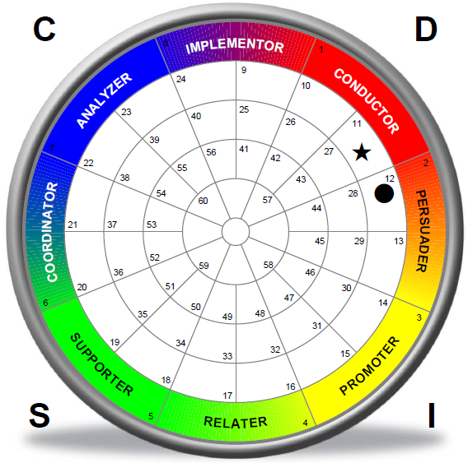
Your business and plans
Culture/Management Assessment
AMR Benchmark and Job Description
PLAN
RECRUIT
Growth…
from Planning to Hiring
ASSESS
Company Culture
INTERVIEW
X
ON-BOARDING
X
COACHING
X
PERFORMANCE
RETENTION
SUCCESSION
© Strategic Talent Management, 2013
6
Notes:
An example of the value of us understanding your business plans—when recently hiring a DIGITAL STRATEGIST my AMR client pointed out that he hoped this person could head up the new department in the near future—so we are looking for MANAGEMENT capable people—not simply a DOER
You need not understand our Culture Assessment for purposes of this presentation—but this graphic does show the 6 core elements of your company culture and we can measure the same factors in individual candidates or employees and tell you precisely how well they will fit to your culture…
Overall we create a TARGET of 3 or more assessments that a candidate must be matched to in order to be considered a viable candidate for hire, promotion or perhaps succession. More on how our actual candidate did in a moment.

Slide 7

Your business and plans
Culture/Management Assessment
AMR Benchmark and Job Description
PLAN
Identify the ideal candidate
Write a behaviorally based ad; seed TMP
RECRUIT
ASSESS
INTERVIEW
ON-BOARDING
COACHING
PERFORMANCE
RETENTION
SUCCESSION
© Strategic Talent Management, 2013
7
Notes:
One key thing I have noticed over time—most of the ads on LinkedIn, Monster, FaceBook, Craigslist, Newspapers or Journals are POORLY WRITTEN.
Example from a client who has a superb and strong focus on customer service—the first full paragraph of the ad was about “pleasing the customer”, “customer is number one”, and even included a short vignette about customer service…
The problem with this is that a DIGITAL STRATEGIST is needed to “develop strategy”, “translate customer plans into digital solutions”, “guide a team of professionals to boost the client’s reach into the market”…the customer, while wonderful in communicating the values of the company, attracted unqualified people who were strong in customer service—and inadvertently dissuaded those who were more qualified and did not see themselves in the opening lines of the ad.

Slide 8
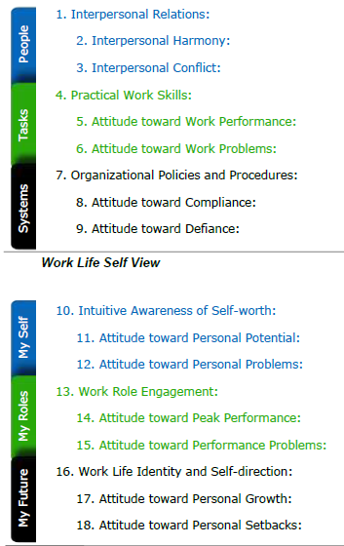
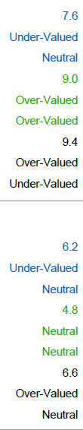
Your business and plans
Culture/Management Assessment
AMR Benchmark and Job Description
PLAN
Identify the ideal candidate
Write a behaviorally based ad; seed TMP
RECRUIT
Automated candidate screening process
1-5 guaranteed top performers to review
ASSESS
INTERVIEW
Specific Answers
ON-BOARDING
Company Culture ‘X’
Candidate ‘O’
COACHING
X
O
PERFORMANCE
O
X
O
X
RETENTION
SUCCESSION
© Strategic Talent Management, 2013
8
Notes:
This is the ASSESSMENT stage—it does not mean our assessment tools alone—this stage will include at least two screening interviews and perhaps an automated survey and resume review.
For the AMR assessments—wanted to give you a quick taste of precisely what we can measure—graphics from 2 of at least three reports we produce on each candidate
In this case I could tell my client that this DIGITAL STRATEGIST candidate is a master of detail and project management and they like to enforce the rules—but may be a bit weak forming RELATIONSHIPS—this may not be as important for a worker level, but could be a disaster moving into Management.
It also shows a low level of Energy and Drive—in fact, they are facing difficult personal and professional situations which may not be corrected simply by RUNNING AWAY to a new job. There is an interest in the future, but they are not clear about the path ahead..
Culture graph (showed you earlier for the company) shows that this person may not FIT the culture.
Latter point: this would not be a major problem for a worker—but a MANAGER with this attitude may not back up their words with action
In any case—the result of this step will be 1-5 top performing candidates….not 50 or 200 resumes, but people who can do the job and do it well.

Slide 9
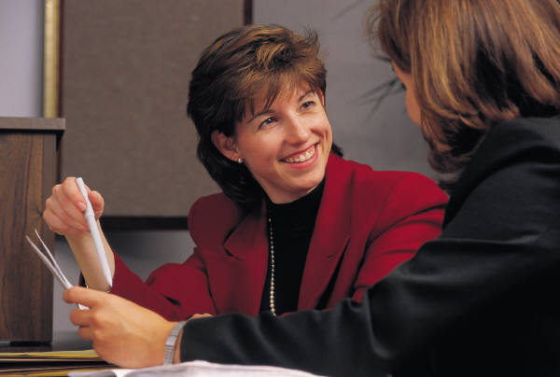
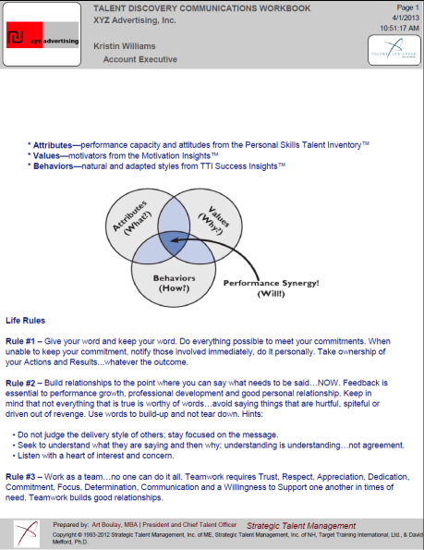
Your business and plans
Culture/Management Assessment
AMR Benchmark and Job Description
PLAN
Identify the ideal candidate
Write a behaviorally based ad; seed TMP
RECRUIT
Automated candidate screening process
1-5 guaranteed top performers to review
ASSESS
Final interviews
Background checks & EEOC reporting
A full Communication & Development package
INTERVIEW
ON-BOARDING
COACHING
PERFORMANCE
RETENTION
SUCCESSION
© Strategic Talent Management, 2013
9
Notes:
The final stage of this “blue section” is where you actually hire someone—and we strongly encourage you to ALWAYS do background checks and be prepared to do EEOC reporting.
What we can uniquely offer, because of the assessments we use, is a thorough COMMUNICATIONS workbook to be reviewed with the new employee.
One thing I like to share about our assessments: Have you ever noticed that if you buy an inexpensive appliance from your favorite department store, you will inevitably get a fat owner’s manual, WRITTEN IN AT LEAST three languages and complete with a trouble shooting guide?
But, when you hire a $50,000 or $150,000 employee—you get a one-page resume! That is it!
We provide 65+ pages of hiring assessments that become an OWNER’S MANUAL the day your hire the candidate.

Slide 10

PLAN
RECRUIT
from On-Boarding to Retention
ASSESS
INTERVIEW
37% of new employees are lost within 30 days
The full TMP process earns our 4|4|4 Guarantee
ON-BOARDING
COACHING
PERFORMANCE
RETENTION
SUCCESSION
© Strategic Talent Management, 2013
10
Notes:
This is the second phase of FROM HIRE TO RETIRE
Overlook ON-BOARDING at your own risk.
37% of new employees typically quit (rarely fired) within 30 days of hire, for lack of a solid ON-BOARDING process.
If you use our TALENT MANAGEMENT PLUS system and the assessments—we will work with you and your new employee for up to four months after employment. We will check in with both of you to assure expectations are being met—
A typical example—the candidate was told he would be able to add 2 more team members who left earlier—the owner gets busy and never pulls the trigger—and it is never discussed again. Sometimes people will share with me a disappointment or frustration they do not feel comfortable bringing up with the owner

Slide 11

PLAN
RECRUIT
ASSESS
INTERVIEW
37% of new employees are lost within 30 days
The full TMP process earns our 4|4|4 Guarantee
ON-BOARDING
Review the assessment in depth with the individual
Take them to their full potential
COACHING
PERFORMANCE
RETENTION
SUCCESSION
© Strategic Talent Management, 2013
11
Notes:
Once your new employee gets settled in, we will sit down with them to review their ASSESSMENT in detail—and in doing so, help them understand the assessments of their team members, immediate supervisor, owner and so on.
The point is to facilitate COMMUNICATION within the new team—we often will do a workshop with the GROUP to help everyone see where they fit in.
We call this step COACHING—but do not interpret that as FIXING the new employee—typically in a small agency, I do not recommend hiring people who need FIXING as there is no time or budget for that.
COACHING is about helping the person see their full potential (as you and I saw it from the hiring process)—help them see the obstacles in their path—and provide tools and support to clear those obstacles.

Slide 12
PLAN
RECRUIT
ASSESS
INTERVIEW
37% of new employees are lost within 30 days
The full TMP process earns our 4|4|4 Guarantee
ON-BOARDING
Review the assessment in depth with the individual
Take them to their full potential
COACHING
Management System
Performance Management
PERFORMANCE
RETENTION
SUCCESSION
© Strategic Talent Management, 2013
12
Notes:
This is best illustrated by a story—the DIGITAL STRATEGIST recently notified me (with a CC to the owner) that they wanted to stay focused on management beyond my normal 3-4 month window—
knowing the company as I do, I recognized that this will be of limited value because there is no well documented, or well understood MANAGEMENT SYSTEM in place.
Nothing to dictate the frequency of team meetings, or how performance is tracked or measured. There are no documented steps for the company managers to come together to solve company wide problems.
I copied the owner and recommended we put these additional coaching $ into an effort to document their current system (there is a system even if no one knows all the pieces).
This is part of the TRANSFORMATION step that I talked about earlier—assessments alone are marvelous—a great new employee to lead your DIGITAL TEAM is a breath of fresh air—but the wheels WILL COME OFF YOUR BUS if your company outgrows its MANAGEMENT SYSTEM.

Slide 13


PLAN
RECRUIT
ASSESS
INTERVIEW
37% of new employees are lost within 30 days
The full TMP process earns our 4|4|4 Guarantee
ON-BOARDING
Review the assessment in depth with the individual
Take them to their full potential
COACHING
Management System
Performance Management
PERFORMANCE
Communication
Training & Development
RETENTION
SUCCESSION
© Strategic Talent Management, 2013
13
Notes:
This slide summarizes this whole phase—reviewing the ASSESSMENTS and working on the MANAGEMENT SYSTEM are grounded in COMMUNICATION work.
TRAINING & DEVELOPMENT may be useful for the whole team or company—a common example is using the ASSESSMENTS to review how they are (or are not) COMMUNICATING, for example.
With this particular company, we have done webinars in the past that reminded people of the need to think about COMMUNICATION, regular MANAGEMENT MMETINGS and PERFORMANCE REVIEWS—
But with so much turmoil in recent years with downsizing and building back up, there are many people in the organization who need reminding, and would benefit taking a step back to look at their colleagues objectively
Often, BTW, we end up talking about difficult clients in these sessions that help people figure out how to successfully communicate with them.

Slide 14

PLAN
RECRUIT
ASSESS
from Succession to the
INTERVIEW
ON-BOARDING
COACHING
PERFORMANCE
RETENTION
Identify & Evaluate employees ready for promotion,
Or employees, family members and outsiders to lead your organization
SUCCESSION
© Strategic Talent Management, 2013
14
Notes:
Every once in a while a small company will call me with a recruiting request…and casually mention that this person is someone they feel could buy them out and allow them to enjoy a rich retirement.
The red flag goes way up the pole at this point.
A successor MUST share the values of the person selling the firm—
they MUST be entrepreneurial to sell, market, and grow the business—
and they MUST be a strong LEADER in order to manage and nudge the firm along—
and there MUST be a strong team in place to complement their particular talents
AND typically the owner is in love with this guy or gal, because they see their ticket to the good life up ahead. Or the candidate is a relative or dear friend in the business—
It is a rare individual who can successfully take the business into the next generation—but we do have the tools to help you make the right decision and help the new owner get the most out of his or her new team.

Slide 15
Using a scientific approach…
“We place the Best person in the Right position the First time.
I guarantee it.”
© Strategic Talent Management, 2013
15

Slide 16

Wrap-up
Q&A
© Strategic Talent Management, 2013
16
Notes:
Final questions, stories, endorsements?

Slide 17
Summary Points
Science and precision will meet your hiring challenge and dramatically improve your results.
Culture, Attitude, Energy & Drive are notoriously hard to measure;
we measure 90+ factors—precisely.
Hiring is more than ads, interviews and payroll forms; think: planning, assessment, automation, screening, on-boarding and retention.
Be prepared to: Measure your culture and management style.
Be prepared for: Transforming your Business into a High Profit Organization.
© Strategic Talent Management, 2013
17
Notes:
KEY POINT:
If you are a long term client—we know your culture as we have assessments for you and your key team—if we are new to one another—the first step is to assess someone on your team to get a sense of the instruments and how I work with you.
The next step, once you and I have reviewed the results, is to assess you and the rest of the team—that gives me a strong platform to work with you and your managers going forward.
Invest in your company and follow the basic outline FROM HIRE TO RETIRE and you will see your PEOPLE RELATED COSTS permanently reduced allowing you to focus on what you do best:
Taking care of your clients, finding new ones and growing the business.

Slide 18
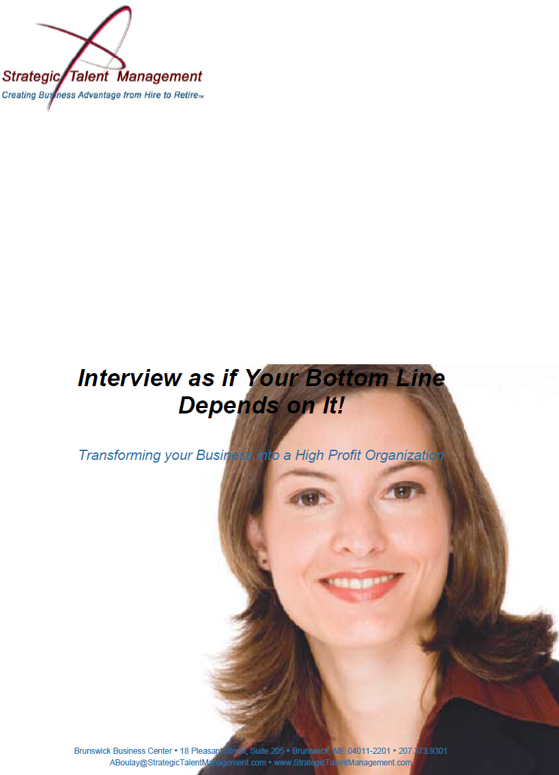
Email me for “Interview as if Your Bottom Line Depends on it!”
Art Boulay, MBA, CMC | CEO
207.373.9301 x104
Strategic Talent Management.com
A Boulay @ Strategic Talent Management.com
Strategic Talent Management
Brunswick Business Center
18 Pleasant Street, Suite 205
Brunswick, ME 04011-2201
USA
Thank-you!
© Strategic Talent Management, 2013
End
Notes:
I have a number of resources to offer—and one of our most popular is this INTERVIEWING GUIDE—INTERVIEW AS IF YOUR BOTTOM LINE DEPENDS ON IT! send me (or Drew) and email and we will get a copy back to you
It is written to users of our assessment tools and provides 10 excellent interviewing tips and lots of examples of how to interview to the assessments.
Thank you so much for listening—please be in touch any time you have a question FROM HIRE TO RETIRE

