Slide 1
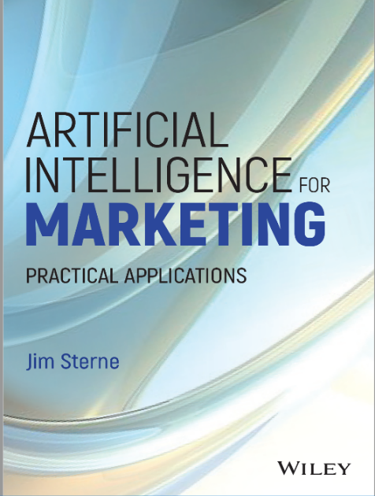
Jim Sterne
Data, Data
Everywhere but
Not a Thought to Think

Slide 2
Reporting is the stripping away of data
for the purposes of communicating
Analysis is the aggregation of data
for purposes of pondering, filtering,
sorting, ranking, comparing, grouping

Slide 3
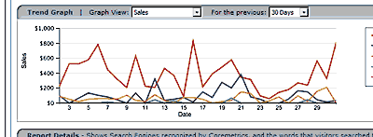
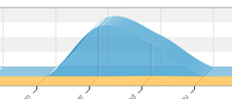
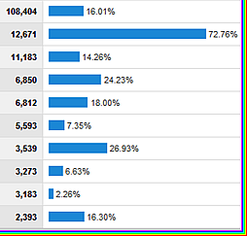
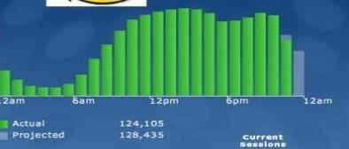
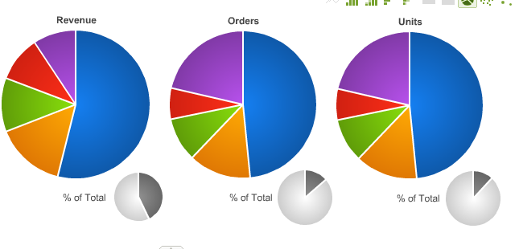
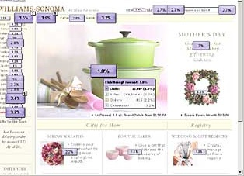
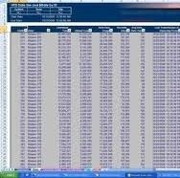
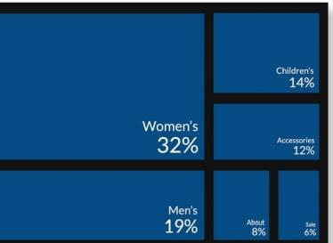
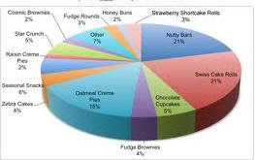
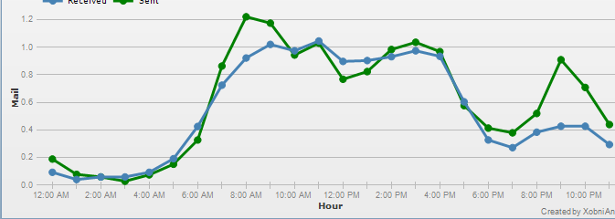
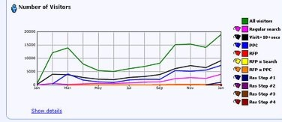
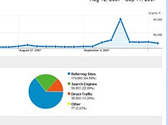
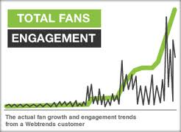
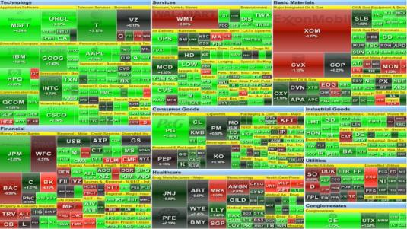
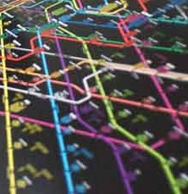

Slide 5
Cognitive Overload

Slide 6
So they start asking...
How many visitors?
Most popular landing page?
Most likes?
PDF downloads?
Time on site?

Slide 7
So they start asking...
What's my heart rate?
What's my blood pressure?
What's my cholesterol level?
What's my platelet count?
What is my lymphocyte score?
What's our bounce rate?
Which content is stickiest?
What is our most popular page?
Which image got the most clicks?
How many people saw this page?
How many times did people go from this email to this page?

Slide 8
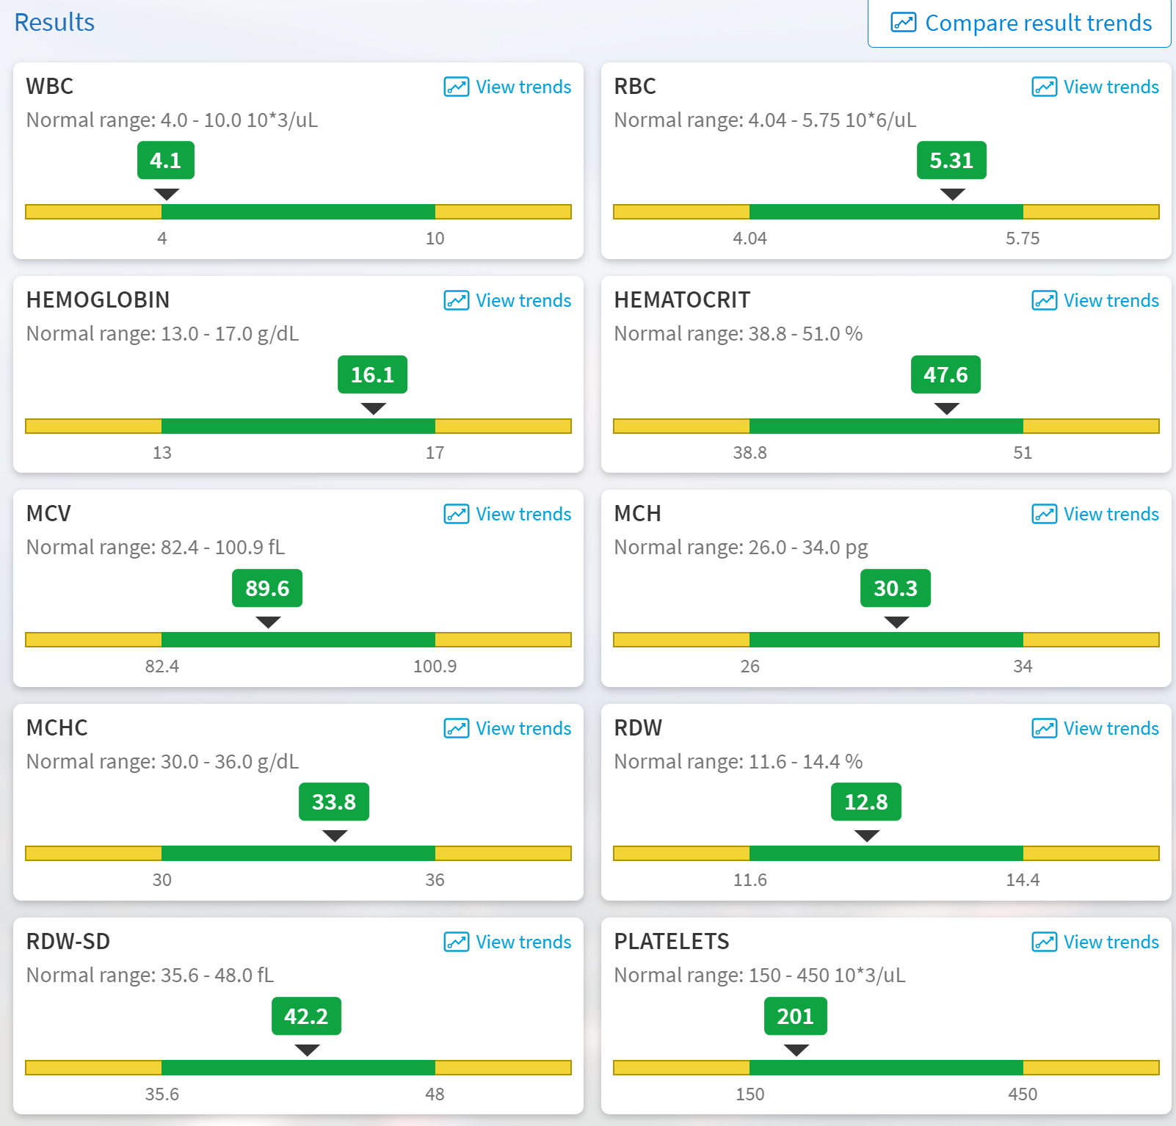
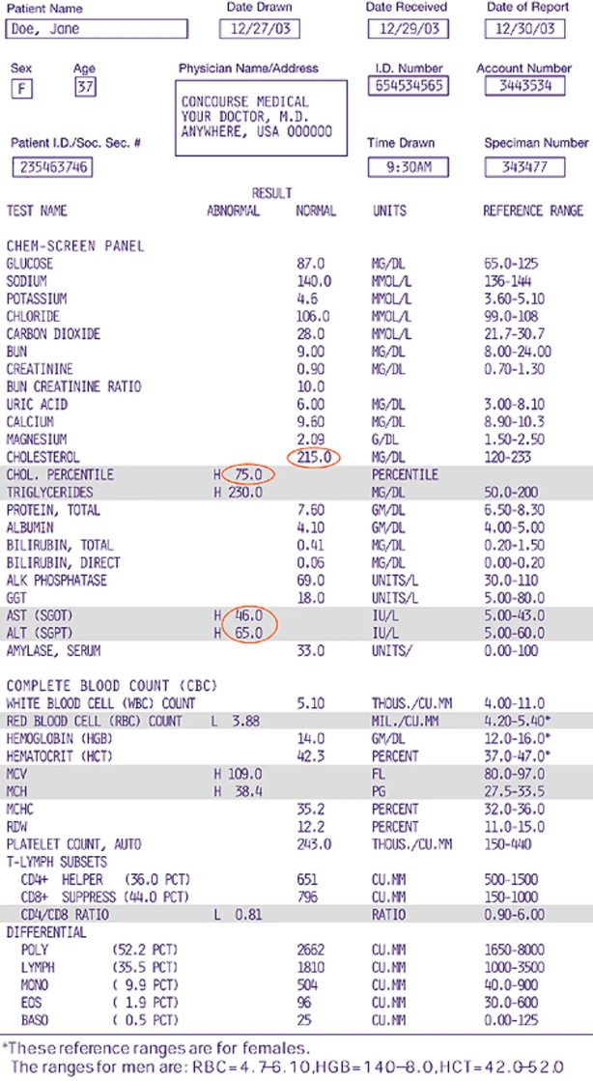
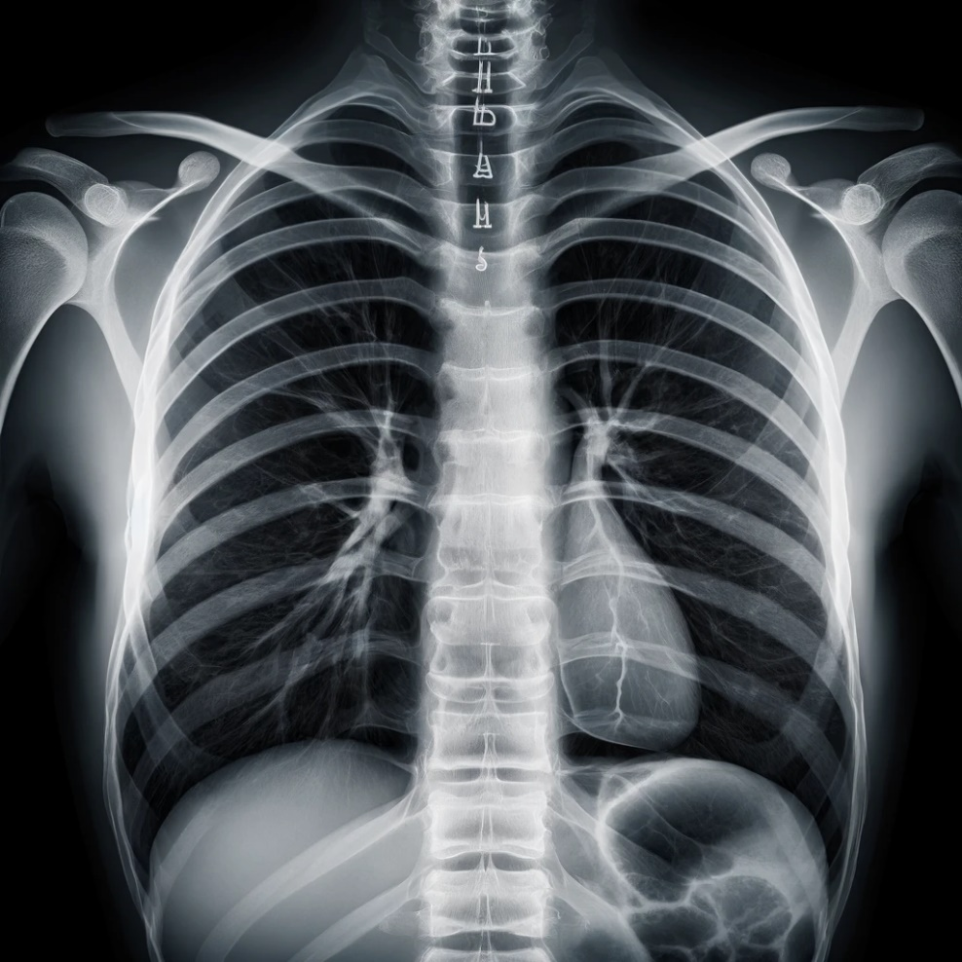
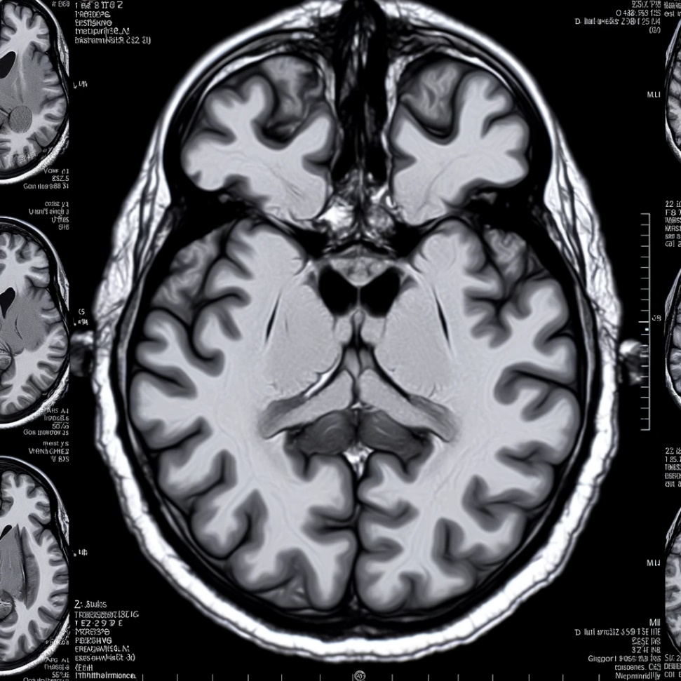
Cognitive Overload

Slide 9
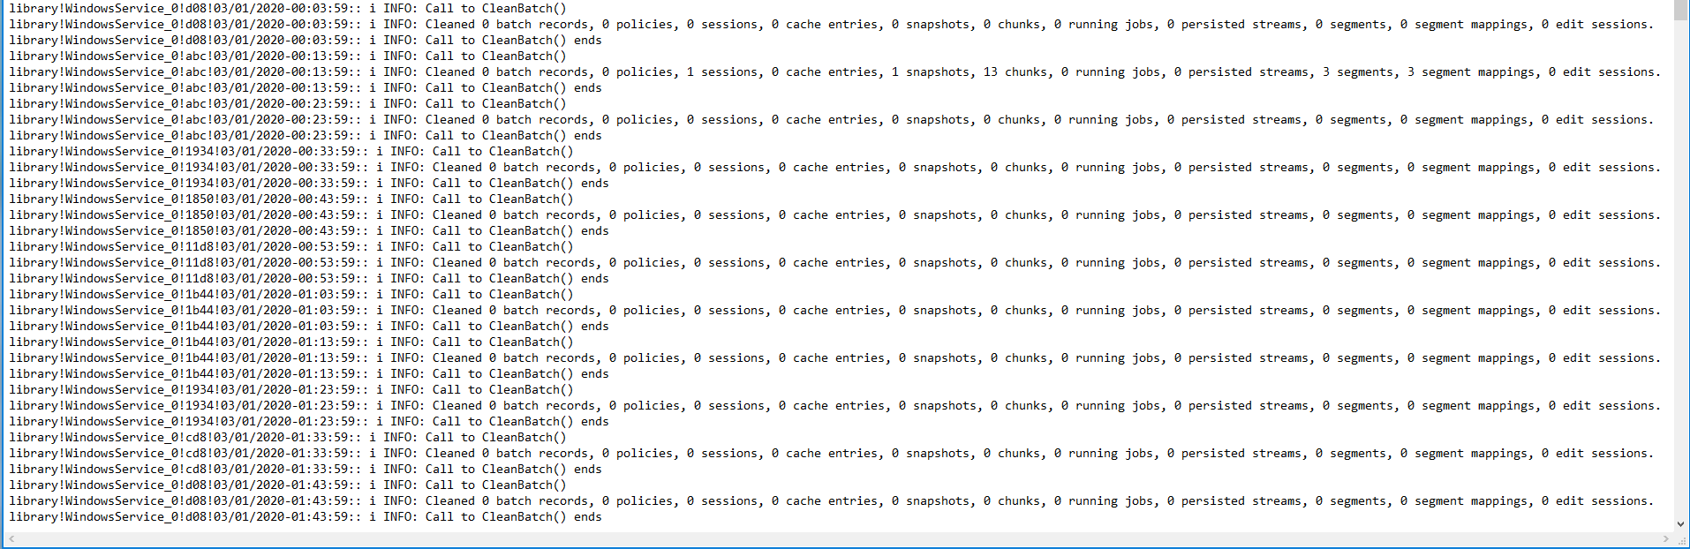
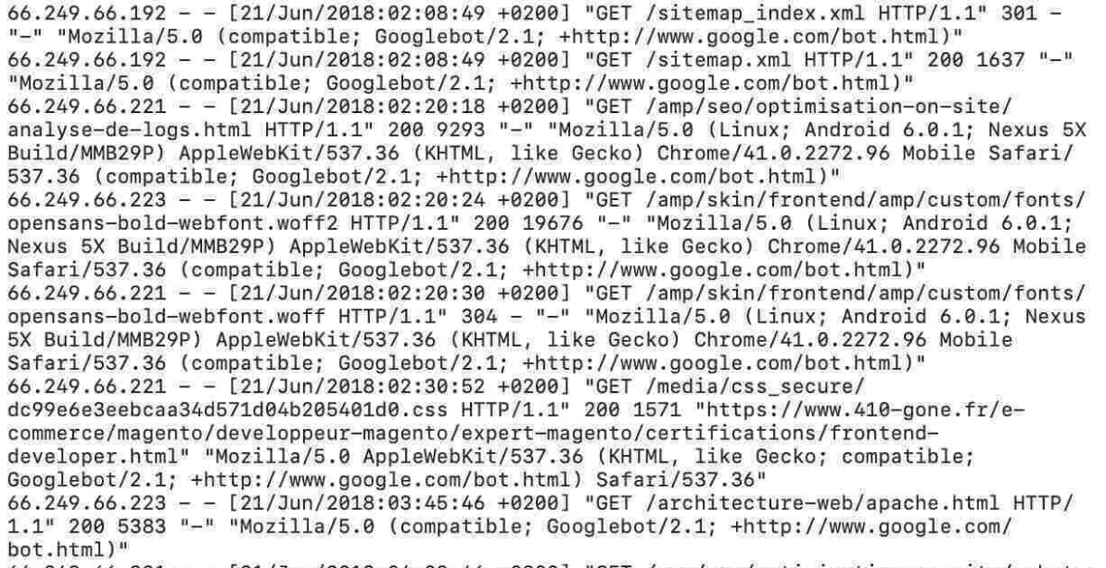
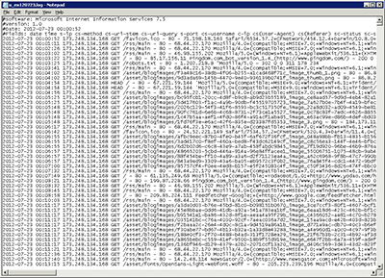
Puzzle: Why Are They Asking?
Data: plural of Datum
Datum: “that which is given”

Slide 10
Puzzle: Why Are They Asking?
Data: plural of Datum
Datum: “that which is given”

Slide 11
Business Goals
Marketing Goals
Increase Revenue
Lower Costs
Improve Customer Sat
Increase Capabilities
Lower Risk
Raise Awareness
Improve Attitude
Inspire Intention
Trigger Interaction
Generate Sales
Drive Endorsements

Slide 12
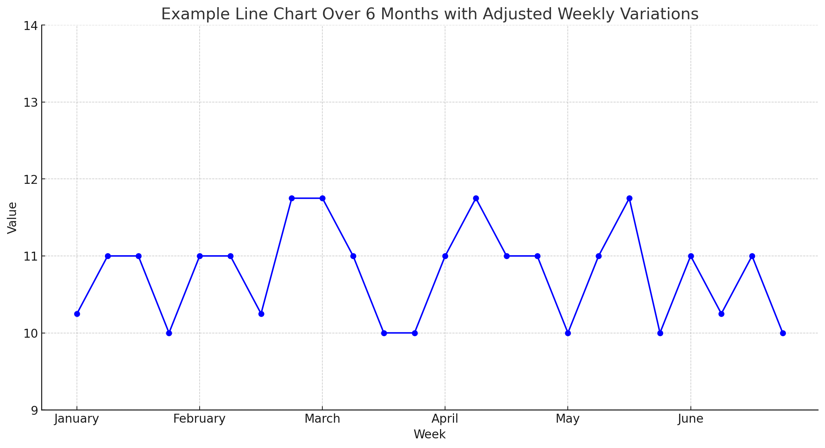
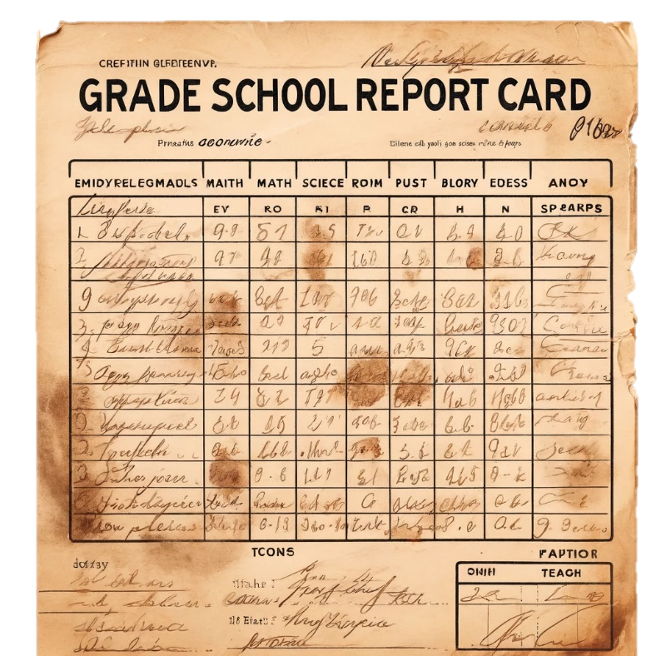

Slide 13
✅ Brushed teeth
✅ Did homework
✅ Did chores

Slide 14
Clear
Concise
✅ Brushed teeth
✅ Did homework
✅ Did chores
Complete

Slide 15
Your goal is to prove success
to generate more billable hours
Internal analyst must show
best numbers over poor results

Slide 16
Business Goals
Marketing Goals
Increase Revenue
Lower Costs
Improve Customer Sat
Increase Capabilities
Lower Risk
Raise Awareness
Improve Attitude
Inspire Intention
Trigger Interaction
Generate Sales
Drive Endorsements

Slide 17
The Data Discovery Process
Can you help us with analytics?

Slide 19
The Data Discovery Process
Can you help us with analytics?
Of course ... I’d be happy to help you!
What aspects of the tapestry of the analytics
landscape are you delving into are
pertinent to you?

Slide 20
The Data Discovery Process
Can you help us with analytics?
Let’s sit down and have The Data Talk

Slide 22
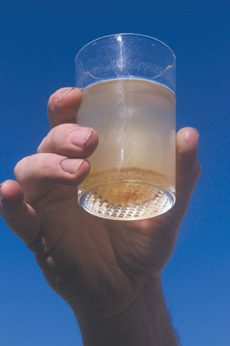
CRM
SFA
UX
CRO
Cust Sat
Cust Serv
Acct
Email
Display
Social
Mobile

Slide 23
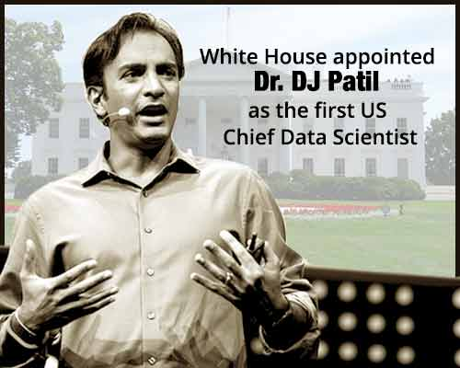
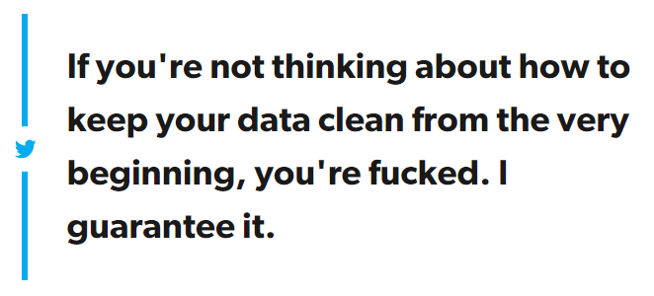
@¢&<

Slide 24
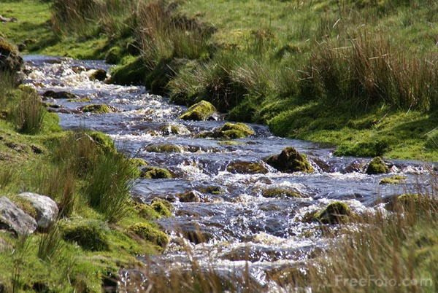

Slide 25
A/B testing
Multivariate testing
Display retargeting
Display response lift
Email customization
Landing page optimization
Recommendation engine
Cart value growth

Slide 27
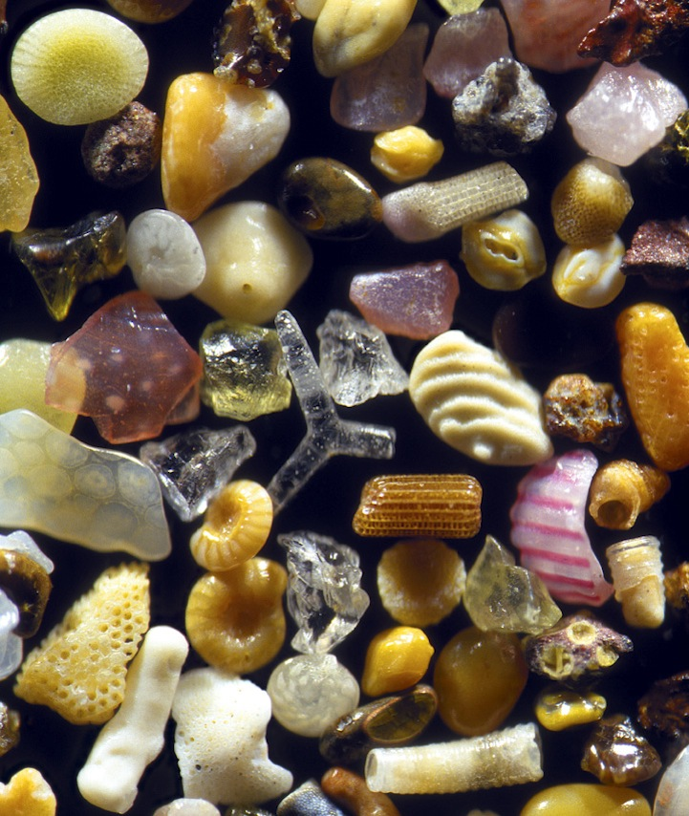
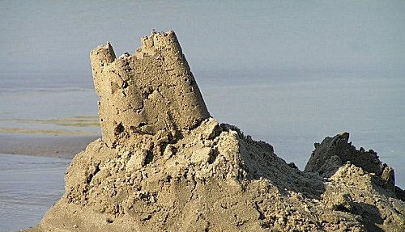
All models are wrong
some models are useful
George Box

Slide 28
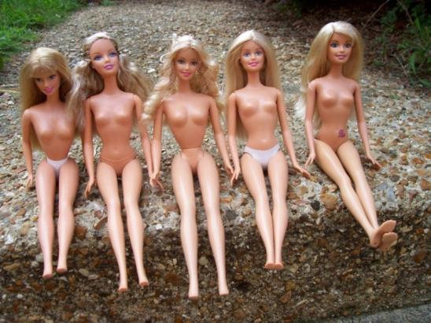
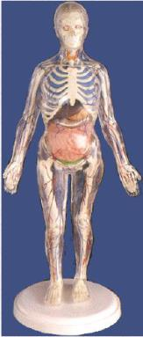
All models are wrong
some models are useful
George Box

Slide 29
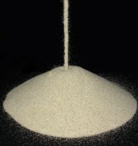
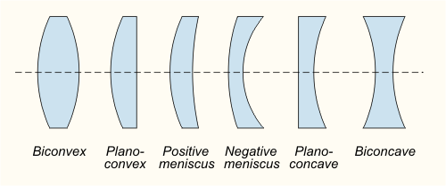
Data
Notes:
How do you get there? Depends on where you are today

Slide 30
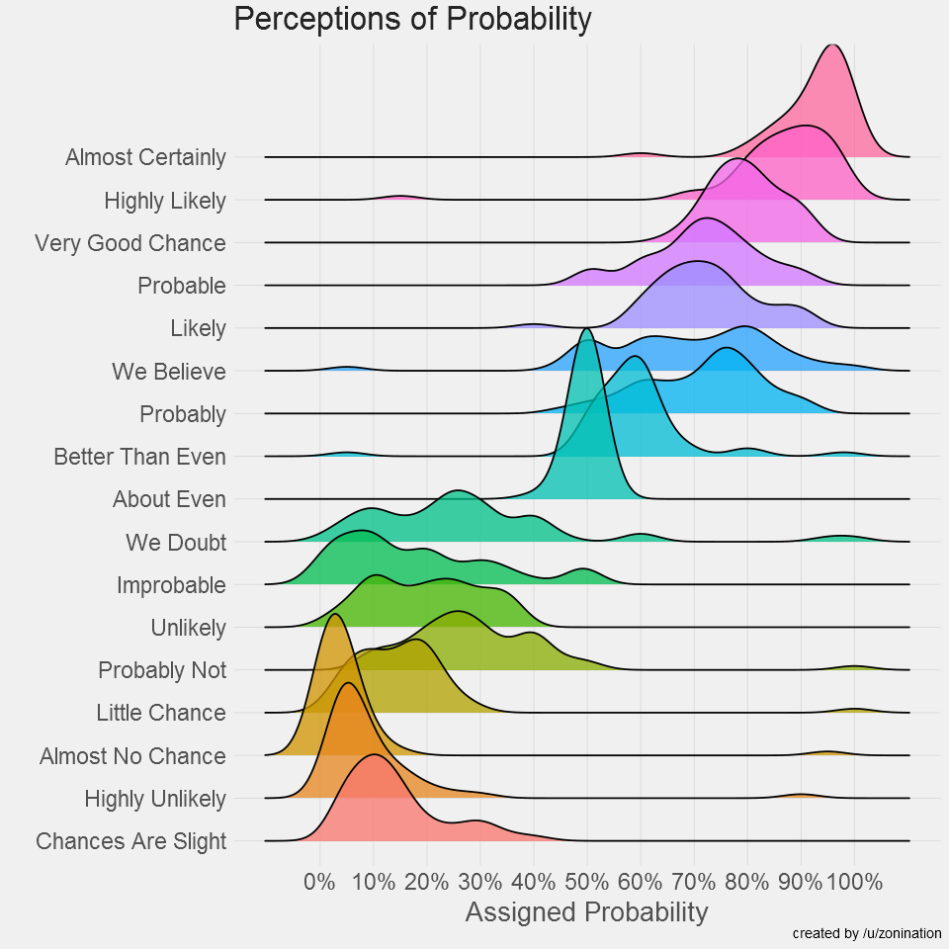
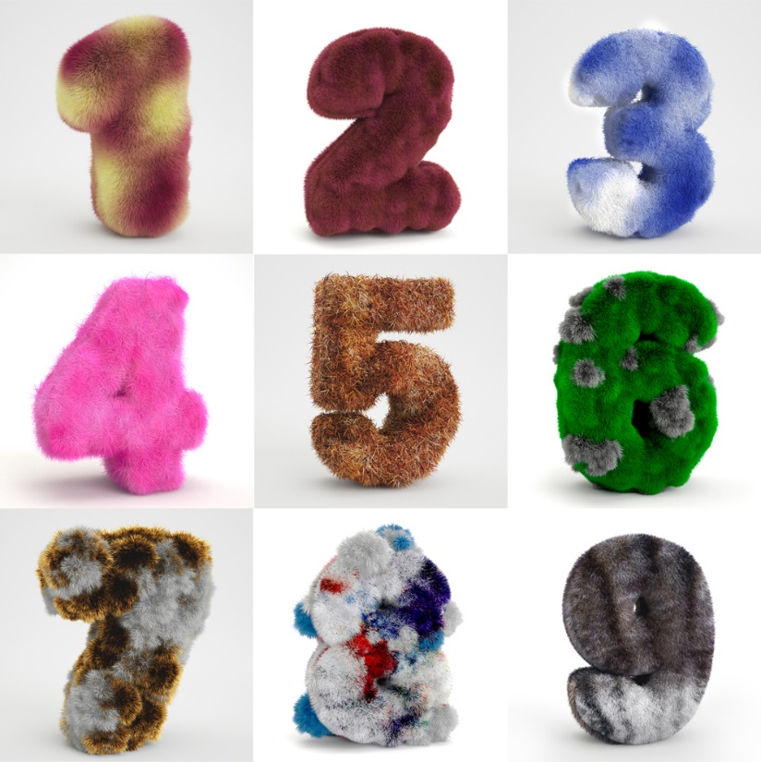
Analytics Numbers are Fuzzy
Fuzzy Numbers
Accounting
Certainty
Inevitability
Determined
Fact
Proven
Statistics
Probability
Likelihood
Chance
Indicator
Projection

Slide 31
The Data Discovery Process
Can you help us with analytics?
What data do you have?
How valid and clean is it?
What tools are you using?
What skills do you already have on your staff?
What are your strategic goals?
Then we need to retag everything
And provide some data literacy training

Slide 32
The Data Discovery Process
Can you help us with analytics?
$
$$
$$$
$$$$
$$$$$
We can do the work and leave it to you
We can do the work and create dashboards for you
We can do the work and become your analytics dept
We can do the work and teach you how to do it
Teach you how to do the work

Slide 33
The Data Lifecycle
Collect
Clean
Integrate
Crunch
Interpret
Deliver
Advise
Google, Facebook, YouTube, LinkedIn

Slide 34
Everybody Agrees
Google Analytics 4

Slide 35
Everybody Agrees
Google Analytics 4
Piwik PRO

Slide 36
The Data Lifecycle
Collect
Clean
Integrate
Crunch
Interpret
Deliver
Advise
Google, Facebook, YouTube, LinkedIn

Slide 37
The Data Lifecycle
Collect
Clean
Integrate
Crunch
Interpret
Deliver
Advise
Google, Facebook, YouTube, LinkedIn
nulls, duplicates, dropouts, corruption
formats, units, cadence, names
calculations, models, predictions
context switching, head scratching, pondering
reports, dashboards, stories
advice, recommendations, testing

Slide 38
The Data Team
1.
2.
3.
4.
5.
6.
7.
Collect
Clean
Integrate
Crunch
Interpret
Deliver
Advise
data engineer
data steward
data wrangler
data scientist
digital analyst
spokesperson / storyteller
trusted advisor

Slide 39
The Data Team
1.
2.
3.
4.
5.
6.
7.
Collect
Clean
Integrate
Crunch
Interpret
Deliver
Advise
Your Agency

Slide 40
The Data Team (outsourced)
1.
2.
3.
4.
5.
6.
7.
Collect
Clean
Integrate
Crunch
Interpret
Deliver
Advise
Your Agency
Data Analytics
Print Production
Event Management

Slide 41
The Data Team (outsourced)
acronym.com
adswerve.com
analyticsdemystified.com
blastam.com
bounteous.com
clickinsight.ca
course5i.com
evolytics.com
factsandfeelings.co
gofurther.com
infotrust.com
rednavelconsulting.com
seerinteractive.com
1.
2.
3.
4.
5.
6.
7.
Collect
Clean
Integrate
Crunch
Interpret
Deliver
Advise
Your Agency
Data Analytics

Slide 42
The Low Hanging Fruit of Analysis

Slide 43
The Low Hanging Fruit of Analysis
Anomalies
Errors & omissions
Complaints
Spikes & troughs
Oddities

Slide 44
The Low Hanging Fruit of Analysis
Anomalies
Errors & omissions
Complaints
Spikes & troughs
Oddities

Slide 45
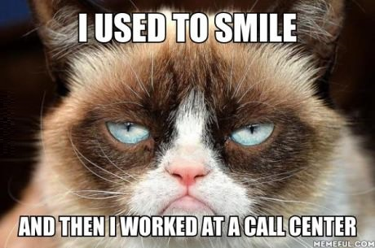
The Low Hanging Fruit of Analysis
Anomalies
Errors & omissions
Complaints
Spikes & troughs
Oddities

Slide 46
The Low Hanging Fruit of Analysis
Anomalies
Errors & omissions
Complaints
Spikes & troughs
Oddities
The most exciting phrase
that heralds new discoveries,
is not Eureka! (I found it) but:
Hmmm, that's funny
- Isaac Asimov

Slide 47
The Low Hanging Fruit of Analysis
Anomalies
The most exciting phrase
that heralds new discoveries,
is not Eureka! (I found it) but:
Hmmm, that's funny
- Isaac Asimov

Slide 48
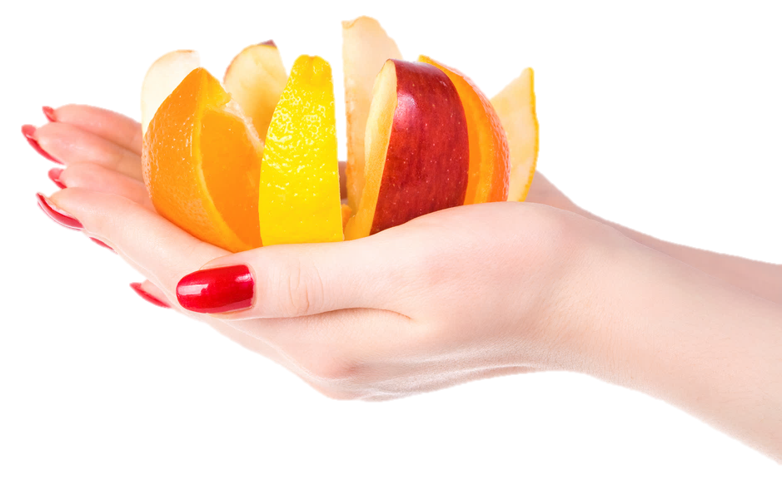
The Low Hanging Fruit of Analysis
Anomalies
Segmentation
Everybody is different
Some people are similar
Find similarities
Test hypotheses

Slide 49
The Low Hanging Fruit of Analysis
Anomalies
Segmentation
Curse of Averages

Slide 50
The Low Hanging Fruit of Analysis
Anomalies
Segmentation
Curse of Averages
Testing
A. Buy one get one free
B. Two for the price of one

Slide 51
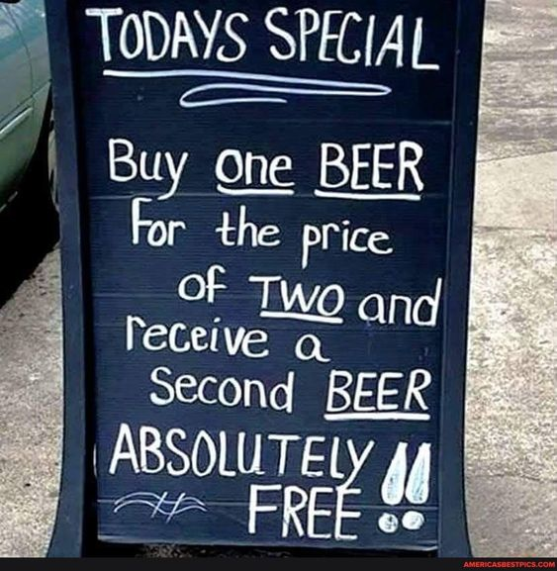
The Low Hanging Fruit of Analysis
Anomalies
Segmentation
Curse of Averages
Testing

Slide 52
The Low Hanging Fruit of Analysis
Anomalies
Segmentation
Curse of Averages
Testing
Collaboration

Slide 53
Creativity
The True Art of Analysis
Is there a pattern?
Is there an anomaly?
What can be omitted?
What if we did it backwards?
What if we look at it sideways?
What if this is the wrong problem?
What if we changed the time scale?
What additional data would be revealing?
What if it had wheels?
What would Chuck Norris do?

Slide 54
The Art of Communication
Tell stories instead of delivering reports
Leave off the sausage making details
Tie everything to the bottom line
Help individuals achieve their goals
Have an opinion

Slide 55
Tell Stories
Once upon a time....

Slide 56
The Art of Communication
Tell stories instead of delivering reports
Leave off the sausage making details
Tie everything to the bottom line
Help individuals achieve their goals
Have an opinion

Slide 57
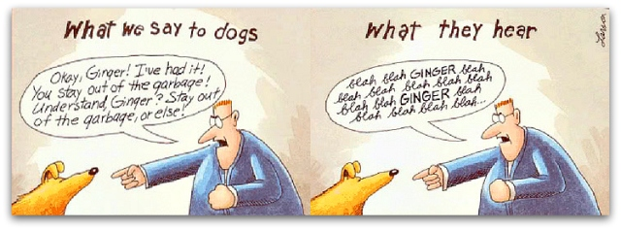
Avoid Gruesome Detail
We Say: They Hear:
Visits Blah
Visitors Blah, blah
Stickiness Blah, blah
Conversion Blah, blah, blah
Bounce Rate Blah, blah, blah
Path Analysis Blah, blah, blah, blah
View Through Blah, blah, blah, blah
Abandonment Blah, blah, blah, blah
Last Click Attribution Blah, blah, blah, blah, blah
Twitter Acceleration Ratios Blah, blah, blah, blah, blah, blah

Slide 58
Communicate Insights Only
Data
Metrics
Reports
Dashboards
Alerts
Automation
Insights

Slide 59
Tie Everything to the Bottom Line
Raise Revenue
Lower Costs
Improve Customer Satisfaction
Increase Competency
Lower Risk

Slide 60
The Art of Communication
Tell stories instead of delivering reports
Leave off the sausage making details
Tie everything to the bottom line
Help individuals achieve their goals

Slide 61
The Art of Communication
Tell stories instead of delivering reports
Leave off the sausage making details
Tie everything to the bottom line
Help individuals achieve their goals
Have an opinion

Slide 62
The Art of Communication
Tell stories instead of delivering reports
Leave off the sausage making details
Tie everything to the bottom line
Help individuals achieve their goals
Have an opinion

Slide 63
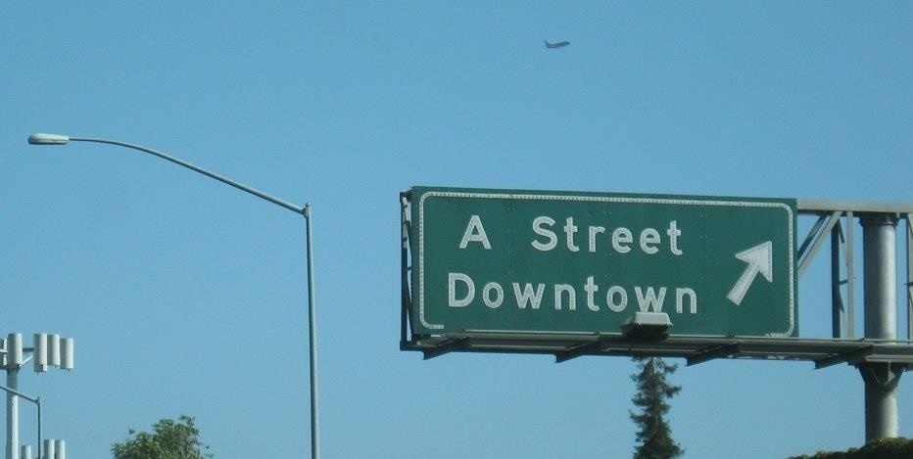

Slide 64
The Art of Communication
Have an Opinion and be Specific
We can improve
this number
by this percent
in this time frame
with this investment
Is it alright with you if
we run this test

Slide 65
Reporting is the stripping away of data
for the purposes of communicating
Analysis is the aggregation of data
for purposes of pondering, filtering,
sorting, ranking, comparing, grouping

Slide 66
Reporting is the stripping away of data
for the purposes of communicating
Analysis is the aggregation of data
for purposes of pondering, filtering,
sorting, ranking, comparing, grouping

Slide 67
Reporting is the stripping away of data
for the purposes of communicating
Analysis is the aggregation of data
for purposes of pondering, filtering,
sorting, ranking, comparing, grouping

Slide 68
The One With the Best Questions Wins
What are you trying to accomplish?
What does success look like?
What will you change if the numbers are too high?
What will you change if the numbers are too low?
This looks interesting – what do you think?

Slide 69
Creativity
The True Art of Analysis
Is there a pattern?
Is there an anomaly?
What can be omitted?
What if we did it backwards?
What if we look at it sideways?
What if this is the wrong problem?
What if we changed the time scale?
What additional data would be revealing?
What if it had wheels?
What would Chuck Norris do?

Slide 70
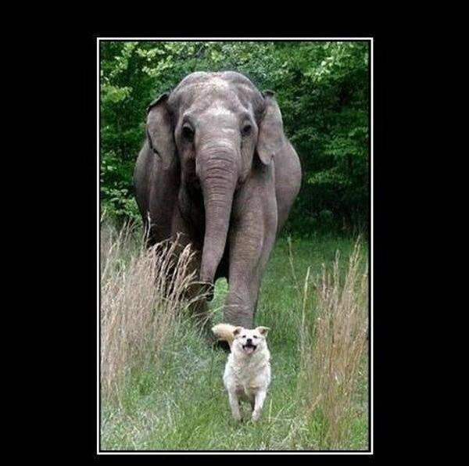
Look what followed me home!
Can we keep it?

Slide 71
This is the dumbest AI
you will ever use
Free Your Mind
- Ethan Mollick
Not a database
Not a search engine
Not a logic system
Not a calculator
Not an encyclopedia

Slide 72
This is the dumbest AI
you will ever use
Free Your Mind
- Ethan Mollick
Tabulate
Calculate
Quantify
Archive
Search
Strategize
Brainstorm
Collaborate
Synthesize
Innovate

Slide 73
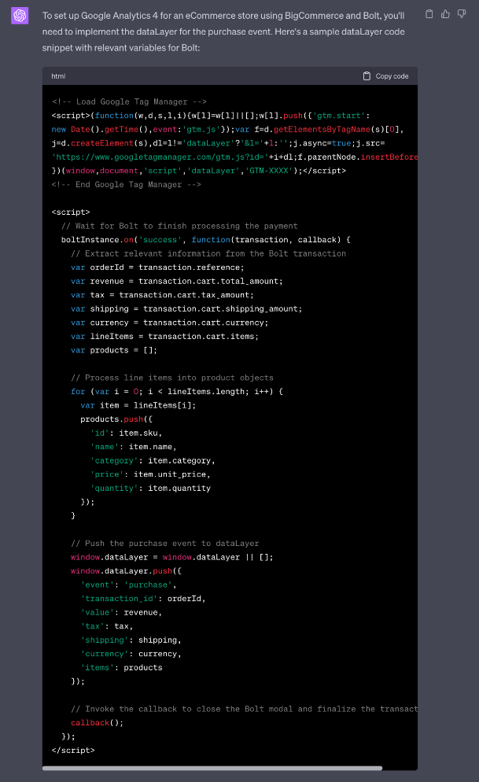
Free Your Mind
Help me write a data layer for GA4

Slide 74
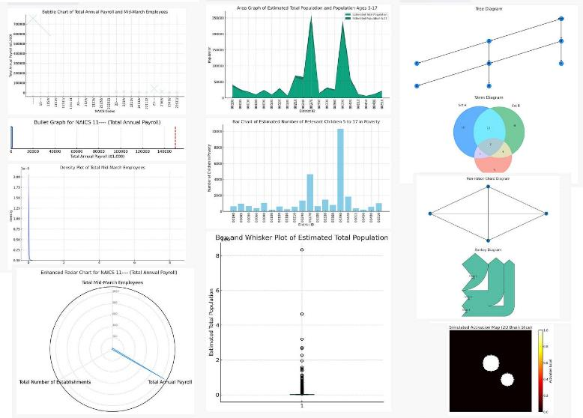
Free Your Mind
Help me write a data layer for GA4
Show me 9 ways to visualize this data

Slide 75
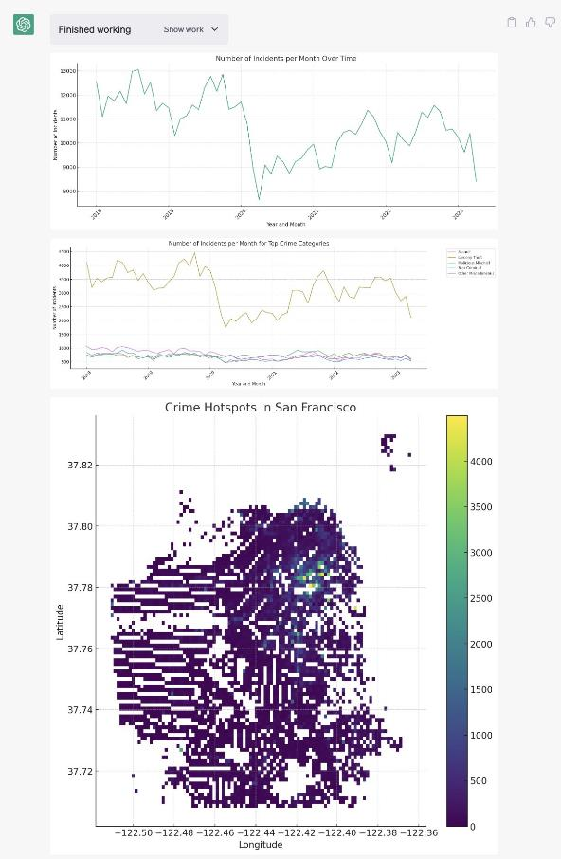
Free Your Mind
Help me write a data layer for GA4
Show me 9 ways to visualize this data
Point out trends over time

Slide 76
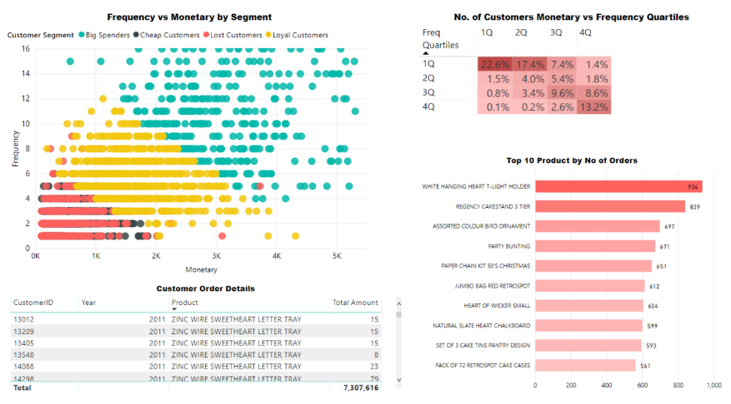
Free Your Mind
Help me write a data layer for GA4
Show me 9 ways to visualize this data
Point out trends over time
Segment my customers
and create a messaging
strategy for each segment

Slide 77
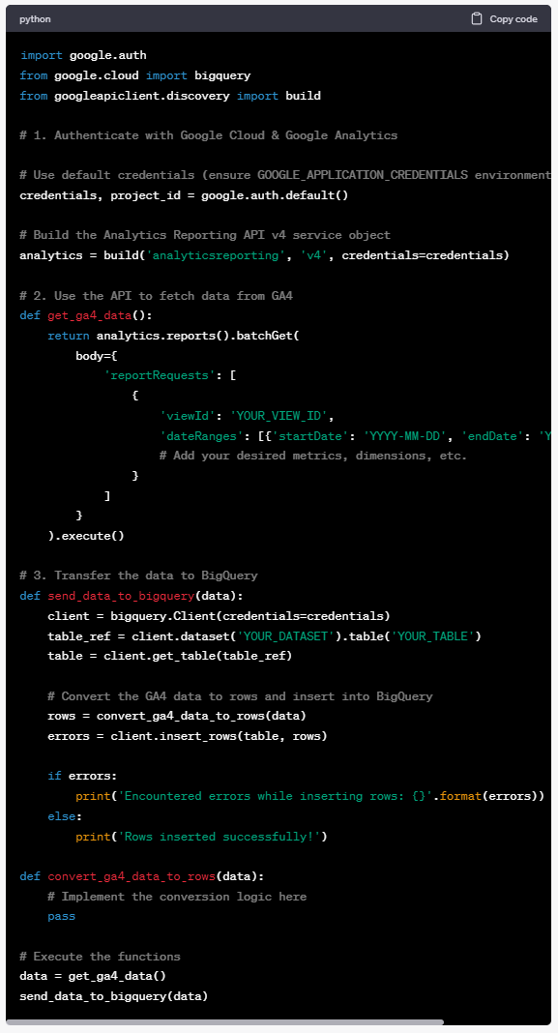
Free Your Mind
Help me write a data layer for GA4
Show me 9 ways to visualize this data
Point out trends over time
Segment my customers
and create a messaging
strategy for each segment
Write a GA4 to BigQuery API

Slide 78
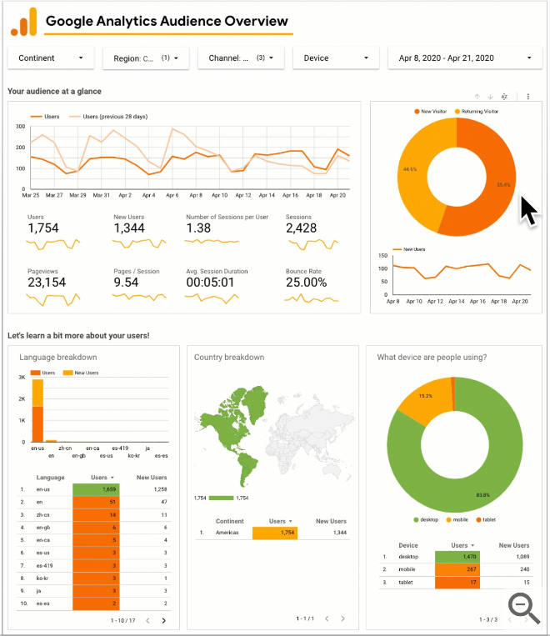
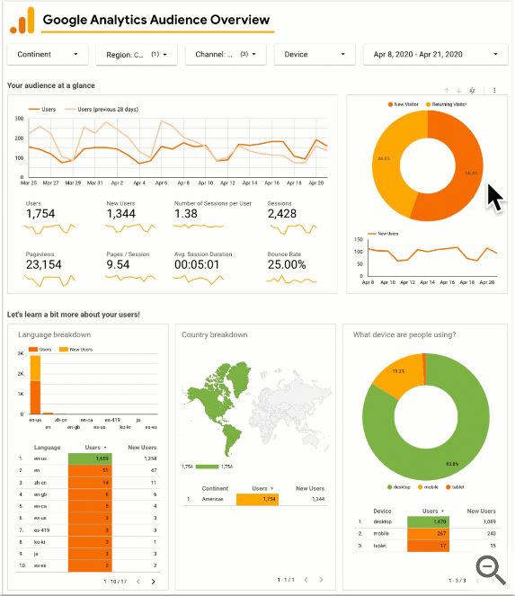
Free Your Mind
Help me write a data layer for GA4
Show me 9 ways to visualize this data
Point out trends over time
Segment my customers
and create a messaging
strategy for each segment
Write a GA4 to BigQuery API
Compare these two dashboards

Slide 79
Three Needs for Humans
What problem?
What data?
Does it pass the smell test?

Slide 80
The Smell Test

Slide 81
The Smell Test

Slide 82
Three Needs for Humans
What problem?
What data?
Does it pass the smell test?

Slide 83
Magic Bullet

Slide 84
Prompt Engineering
Ask for assistance
If the score is below 9 try to improve it. Repeat the critique process until a response gets a 9 or a 10.
After every prompt, give a
normal response then
criticize yourself harshly.
Tell me why the response is bad,
then score it between 1 to 10.
Prompt: What’s the best analogy for generative AI for ad agencies to understand the size of the shift it represents and offer a hopeful path forward?
https://www.facebook.com/groups/633920941560768/posts/726423618977166

Slide 85
Prompt Engineering
Ask for assistance

Slide 86
Prompt Engineering
Ask for assistance

Slide 87
Prompt Engineering
Ask for assistance

Slide 88
Prompt Engineering
Ask for assistance

Slide 89
What’s Next?
Dishwasher fail in 30 days at 90%
12 models fit kitchen dimensions
5 models fit kitchen style
3 models fit budget
2 model fits schedule
Negotiated best price
Install Wednesday
Most stars or best reviews ?
Photo by Lucas Benjamin on Unsplash
Photo by Rock'n Roll Monkey on Unsplash

Slide 90
What Now?
Data Literacy
AI Literacy
Increase Revenue
Lower Costs
Improve Customer Sat
Increase Capabilities
Lower Risk
Stories

Slide 91
Jim Sterne
Data, Data
Everywhere but
Not a Thought to Think

Slide 92
Jim Sterne
Data, Data
Everywhere and
LOTS of Thoughts to Think
Best Questions
Best Vision
Best Strategy
Best Data
Best Algorithm
Best Technology

Slide 93
Jim Sterne
Data, Data
Everywhere and
LOTS of Thoughts to Think
The ones with the
best questions
win

Slide 94
Jim Sterne
Data, Data
Everywhere and
LOTS of Thoughts to Think

